Slide 1
Share The Care
Rough Draft – Version 3
2/27/2018

Slide 2
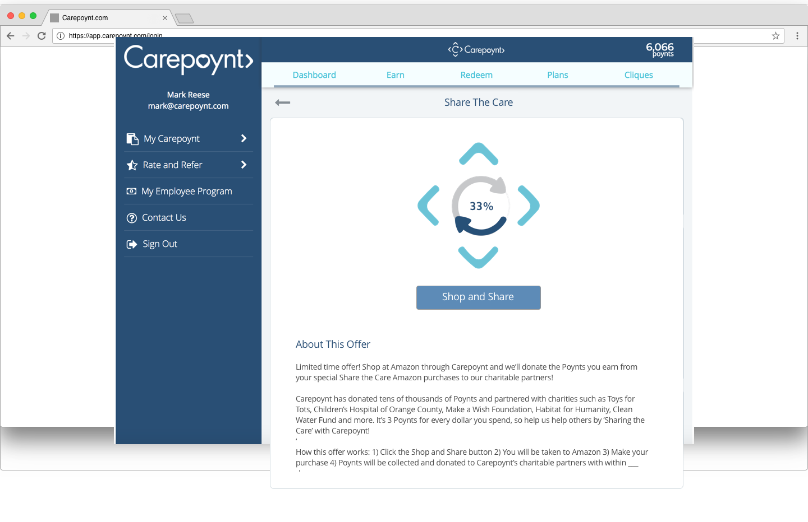
Step 2 – Share The Care Page - Meter

Slide 3
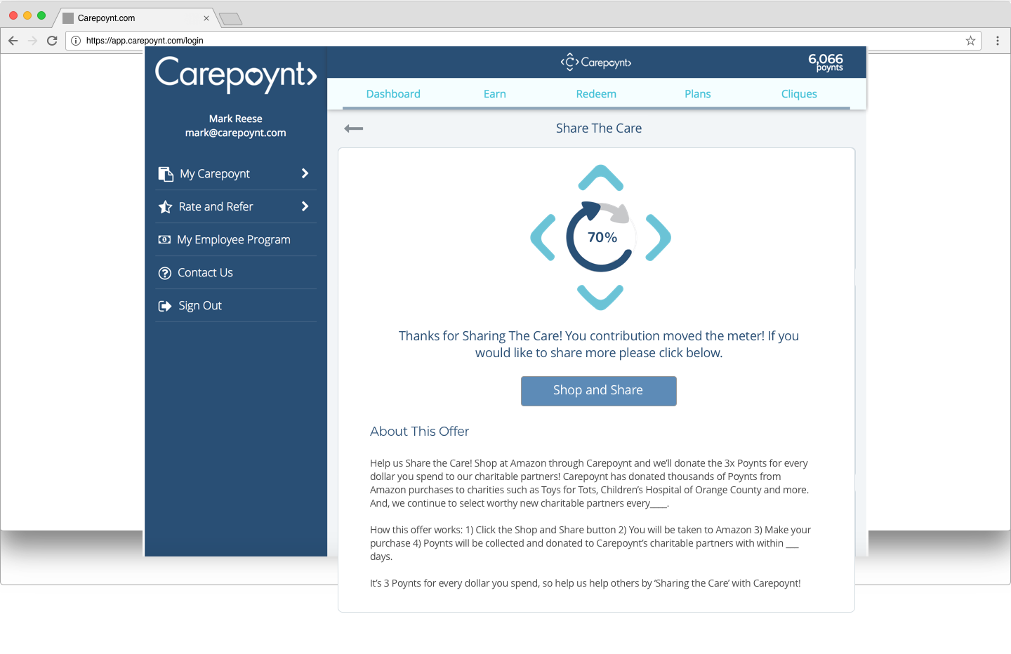
Step 4 v2 – Return to Share The Care Page w/ point info - Unicorn
This page is going to reflect once user has completed their purchase and their poynts recorded.

